Slide 1
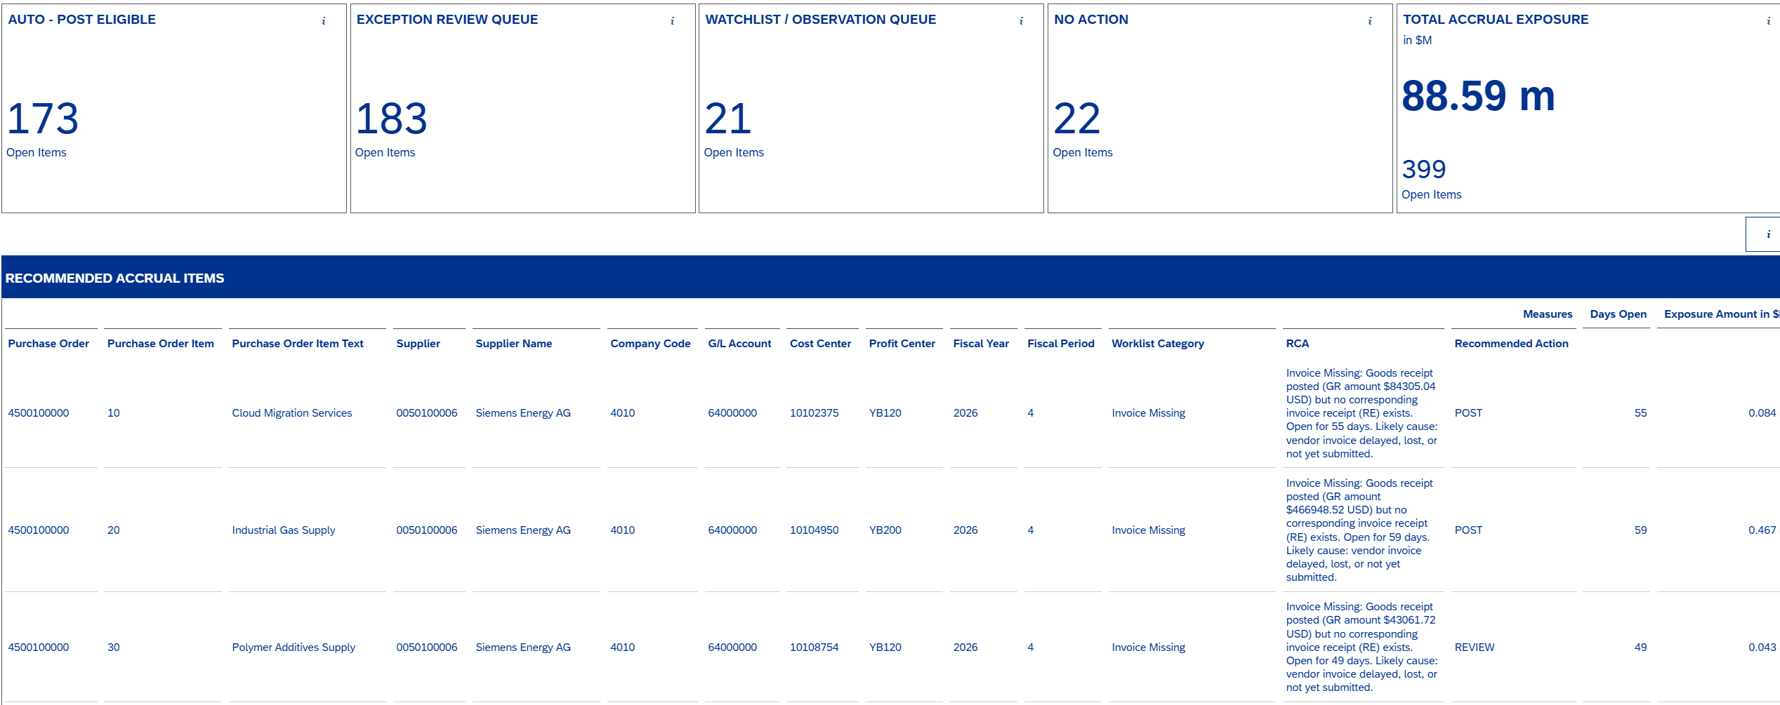
Accrual Worklist

Slide 2
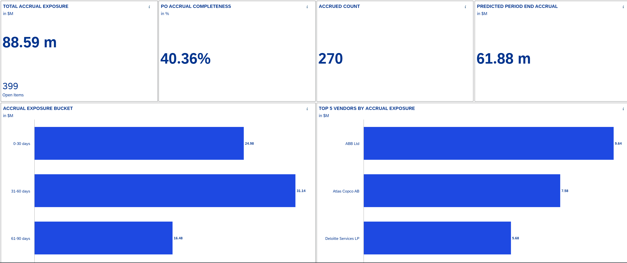
Executive Summary

Slide 3
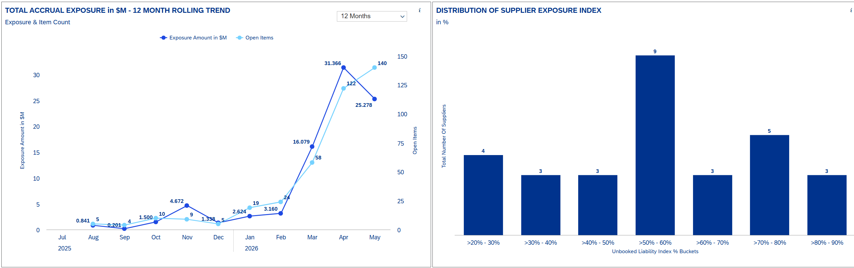
Trends and Spikes (Slide 3)

Slide 4
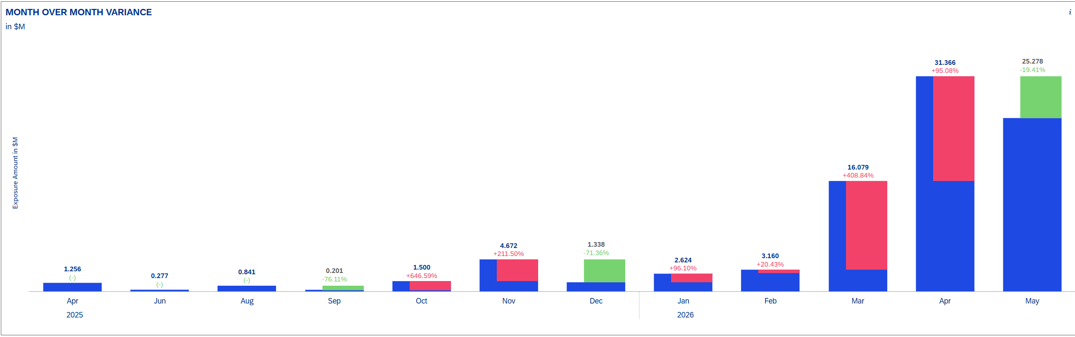
Trends and Spikes (Slide 3)

Slide 5
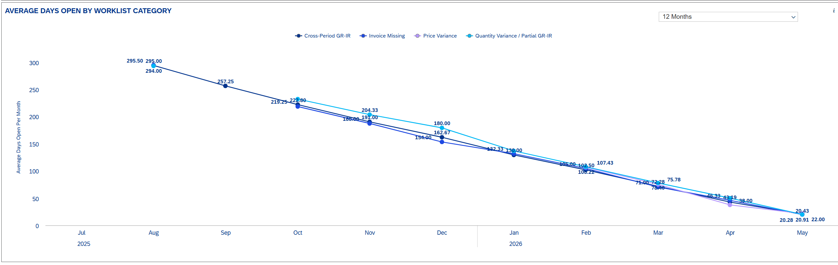
Trends and Spikes (Slide 3)

Slide 6
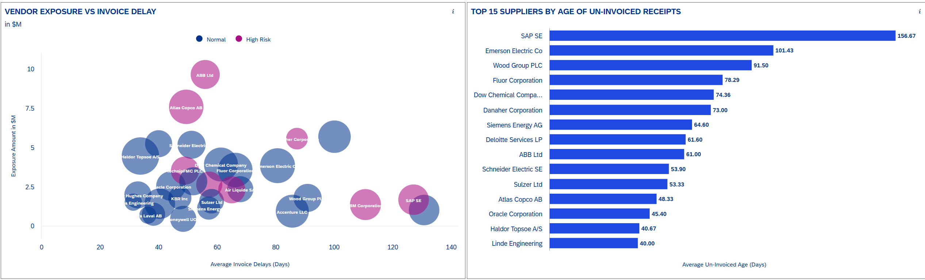
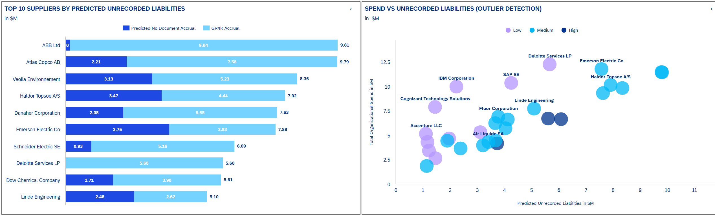
Vendor Intelligence

